Slide 1

HINDWARE ALCHYMI
JAMDAGNI TRADERS
NAJAFGRAH
CONCEPT AND SOLUTIONS METFAB PVT. LTD

Slide 2
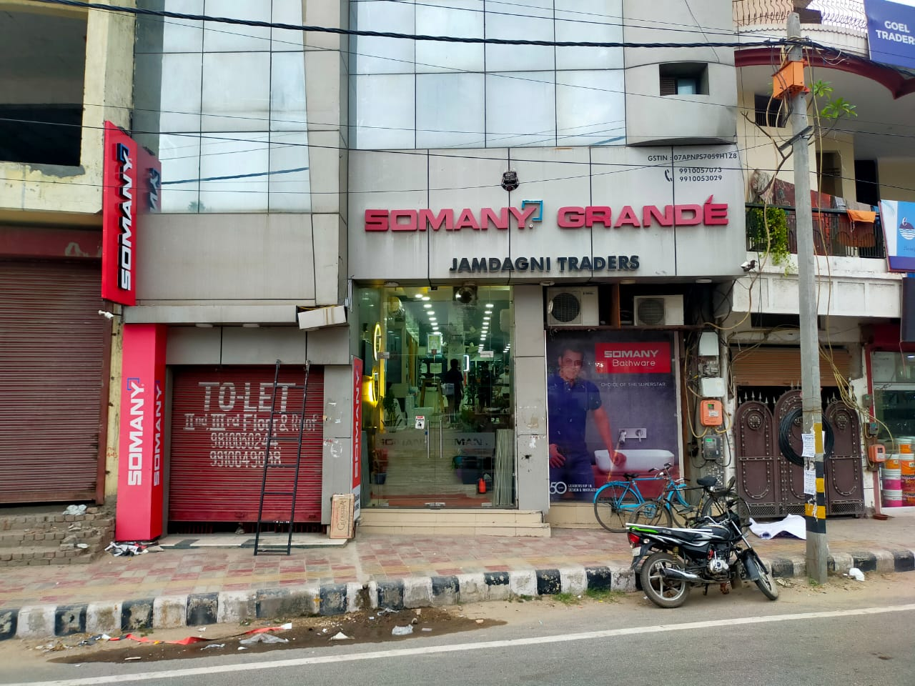

Slide 3
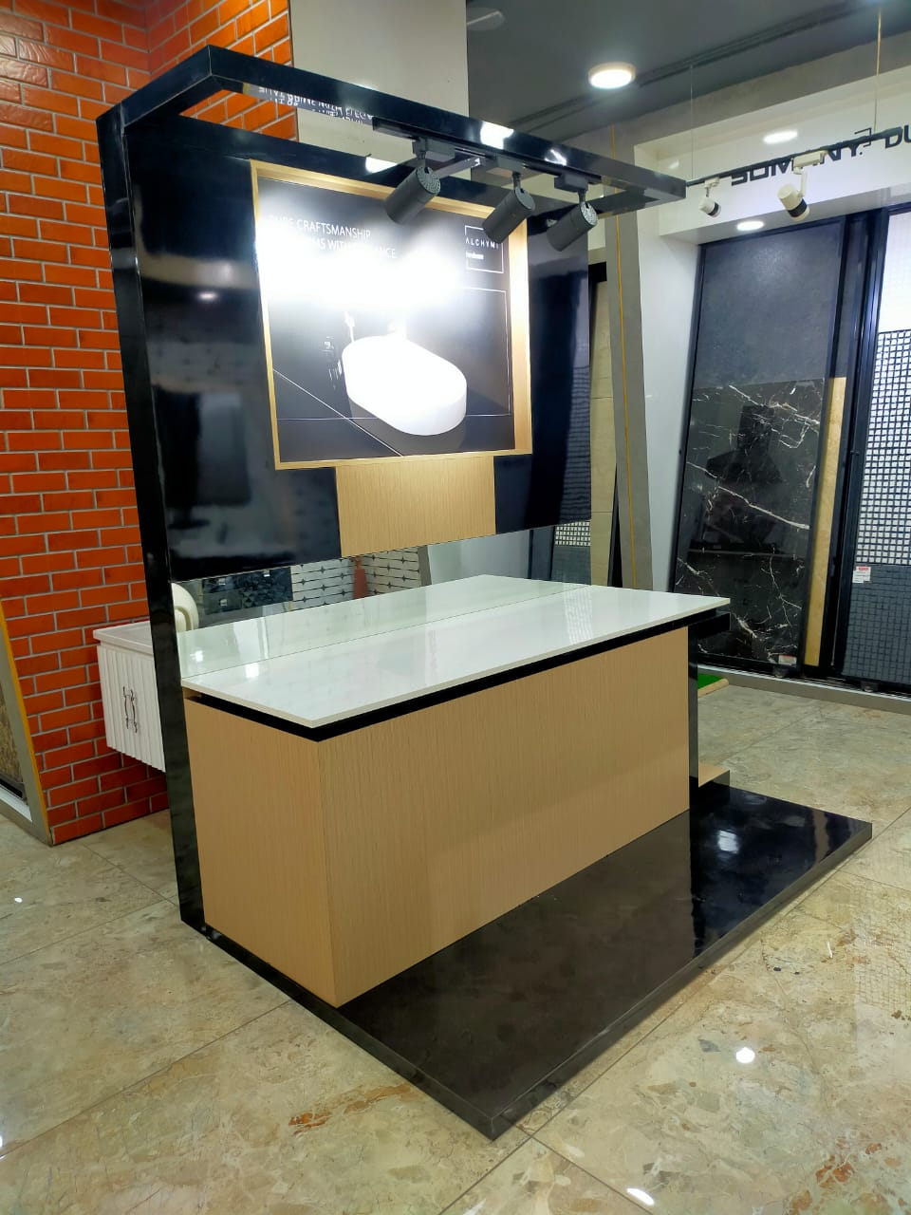
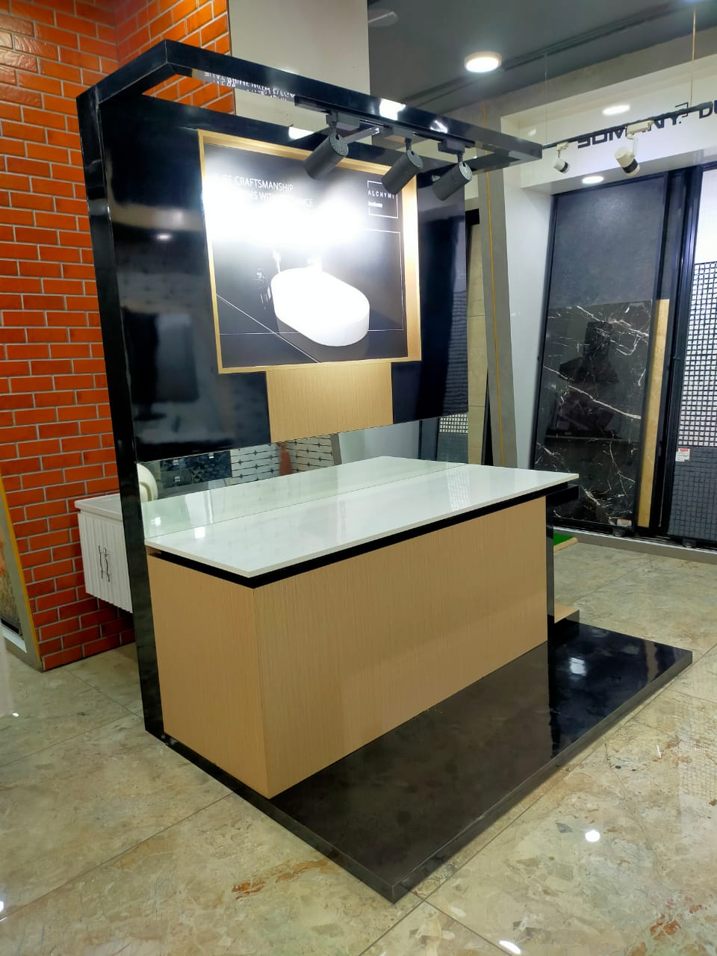

Slide 4
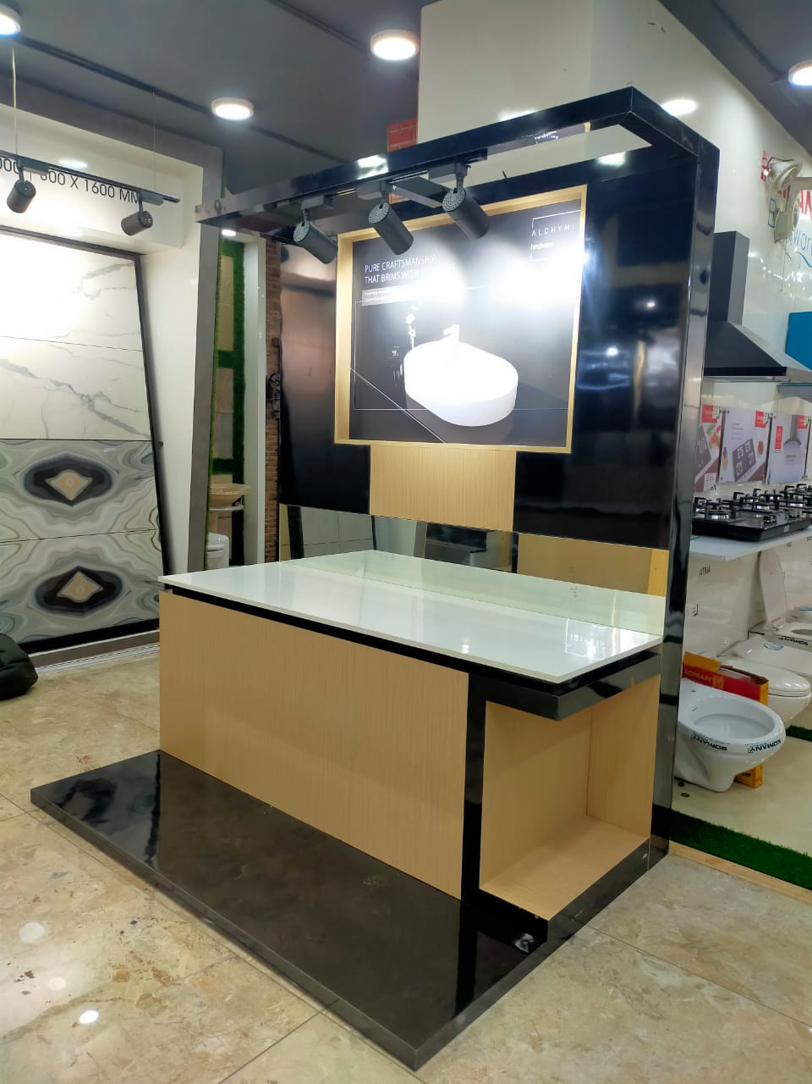
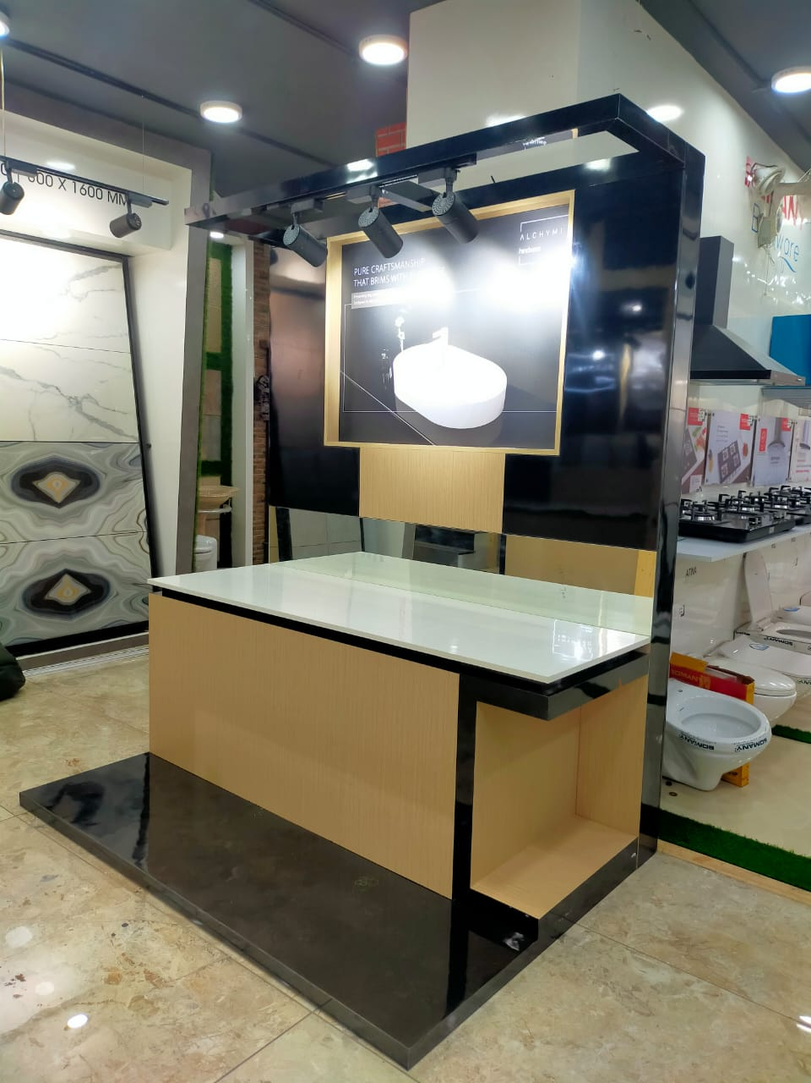

Slide 5
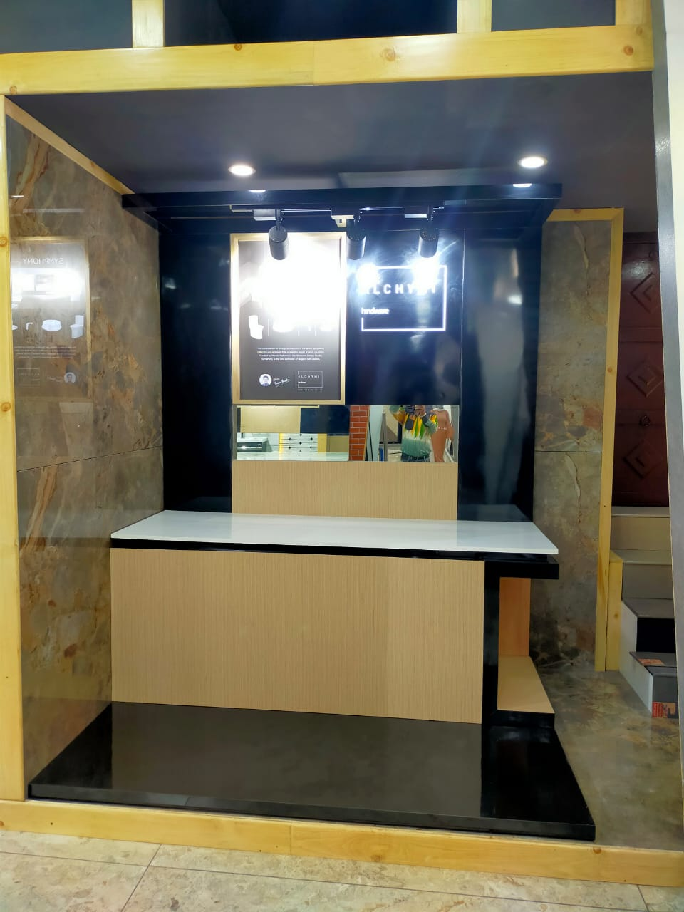
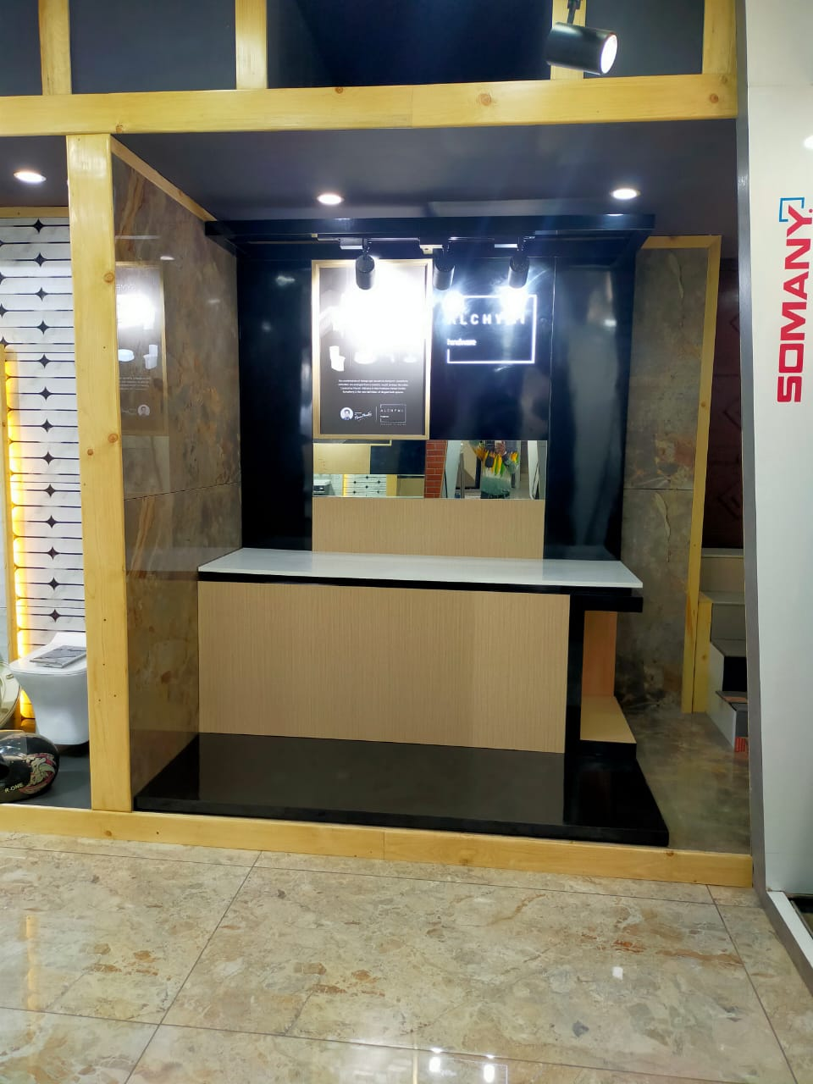

Slide 6
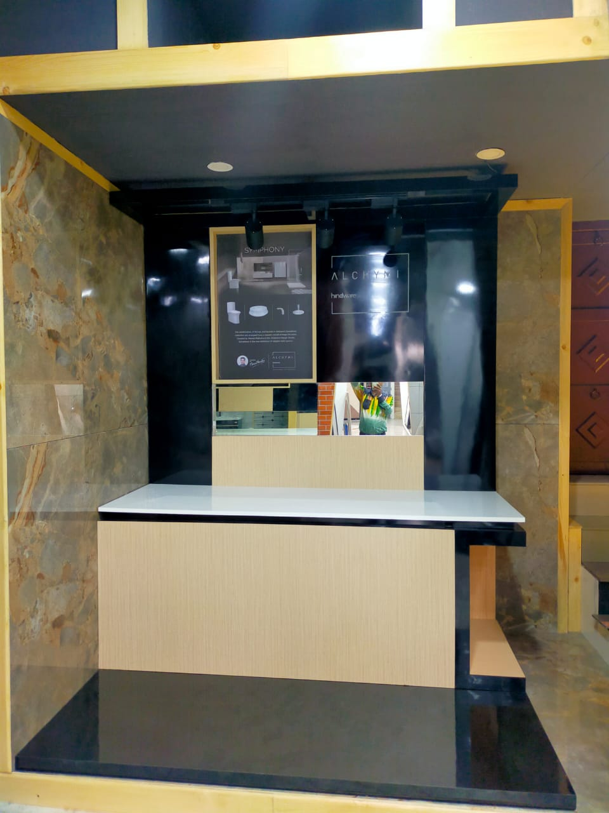
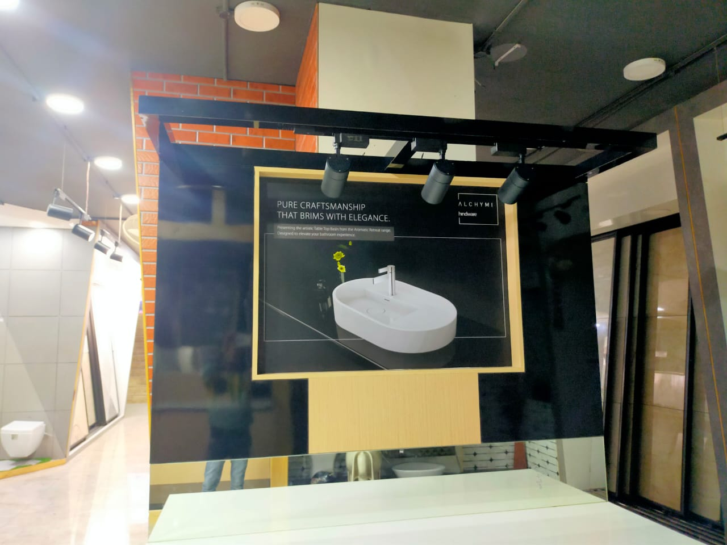

Slide 7
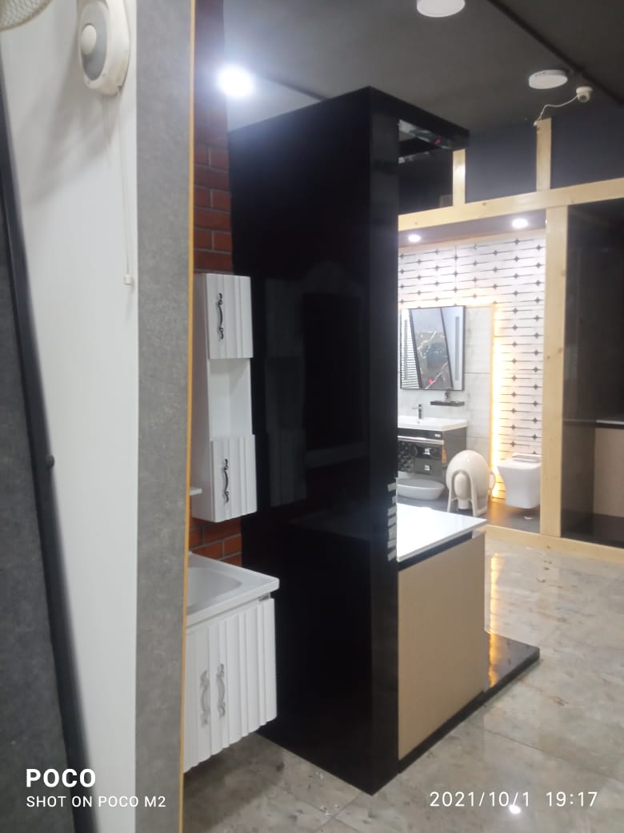
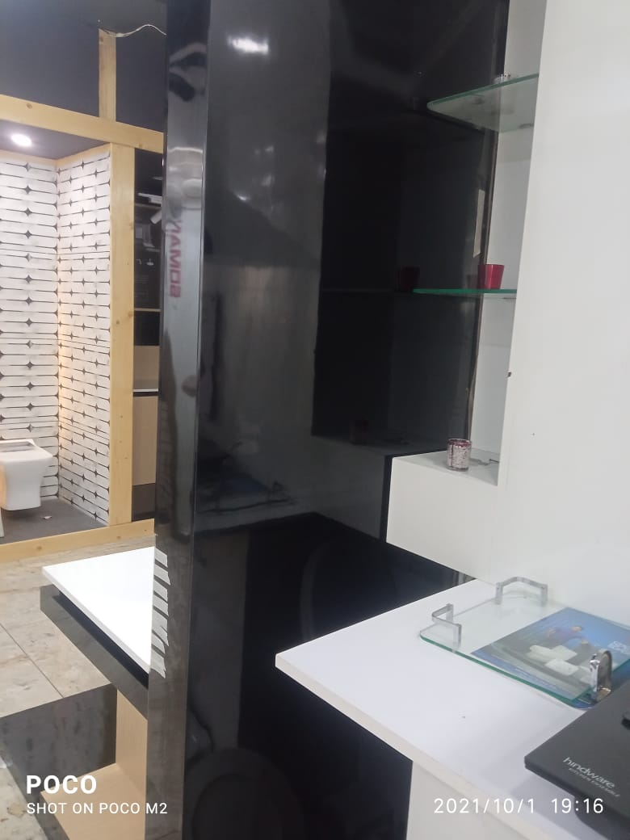

Slide 8
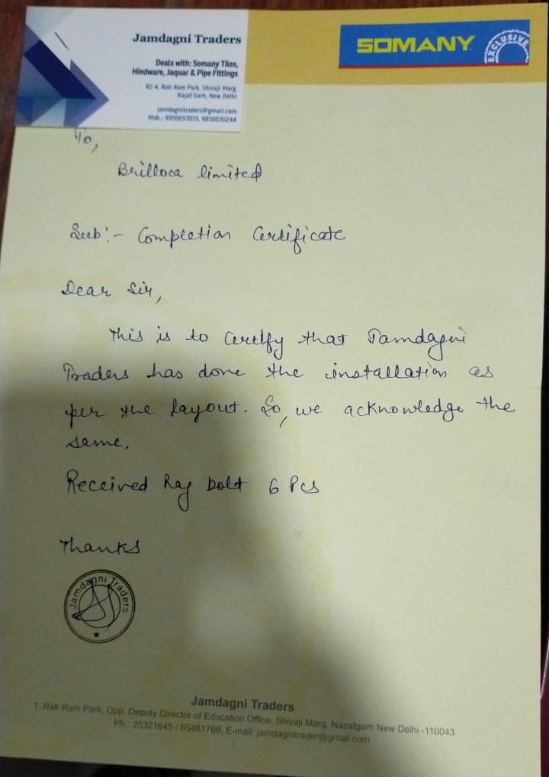
Sign off

Slide 9

THANK YOU
CONCEPT AND SOLUTIONS METFAB PVT. LTD
All rights reserved. No part of this design may be reproduced, stored in a retrieval system or transmitted in any form or by means electronic, mechanical, photocopying, recording or otherwise, without the written permission of the designing company herein called C&S. This is the property of Concept & Solutions Metfab Pvt. Ltd. The design shall not be sold, rented or held by anybody without the written permission of C&S.

